Slide 1
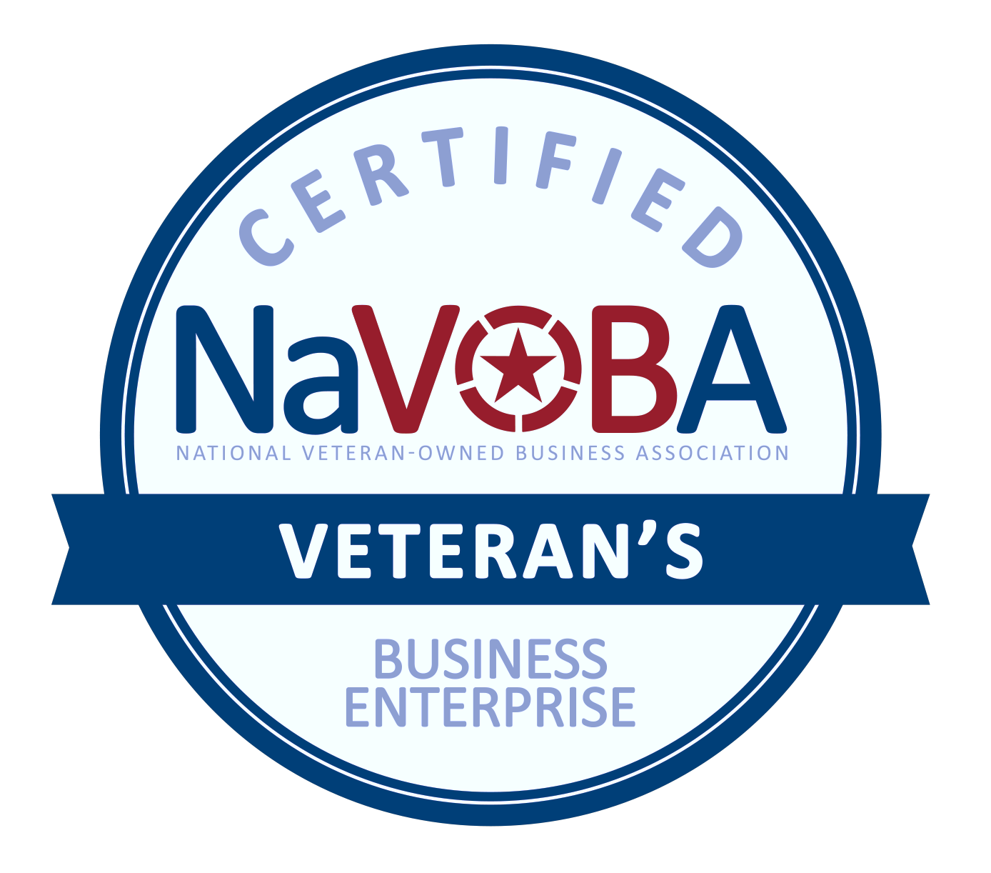
Dr. Paris Love, CEO and Founder
Paris Love Productivity Institute, LLC
770-722-2748
www.drparislove.com
Paris@ParisLoveProductivityInstitute.com
www.linkedin.com/in/parislove
PARIS LOVE PRODUCTIVITY INSTITUTE, LLC
CAPABILITIES:
The Paris Love Productivity Institute, LLC (PLPI) provides services to Fortune 250 and Fortune 500 companies helping them improve productivity and efficiently within the workplace. We assist them in doing the things they always talk about but never get around to doing. These combined businesses employed over 30,000 individuals. On average, we increase staff engagement and productivity by 30% and assist with retention and accountability of their workforce.
We offer a time personality assessment with a five-step process to promote, improve, and evaluate the productivity and efficiency of an organization. After the initial assessment, we provide a 30-day accountability follow-up to ensure the success of the organization and its employees.
PAST PERFORMANCE
COMMERCIAL CUSTOMERS:
Differentiators:
Minimizing problems and increasing employee retention
Improved work-flow efficiency and processes
Minimizing wasted time and maximizing office and employee efficiency
Accountability among teams
Creating more engaged and happy employees
1:1 personalized coaching
Fifth Third Bank
Blu Banyan
Strategic Wealth Specialists
Minority Business Enterprise
DMH Investments
Incredible One Enterprises
National Veteran-Owned Business Association (NAVOBA)
Bunker Labs
We pride ourselves on getting to the root of the problem, so you and your team can effectively maximize your time, energy, and resources.
CODES:
NAICS 611430 Professional and Management Development Training
NAICS 541611 Management Consulting Services
DUNS NUMBER: 014674430 CAGE: 80S91

